Slide 1

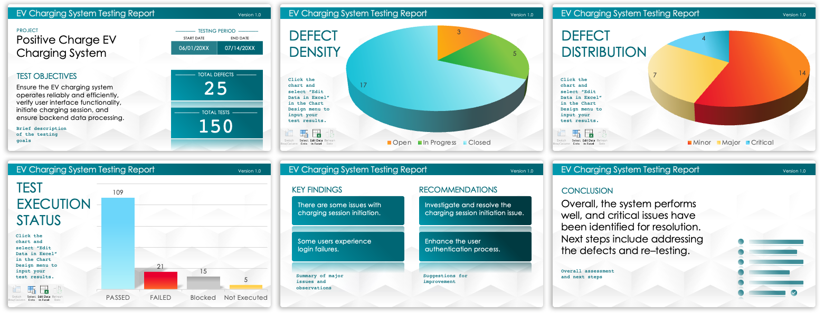
Agile Test Summary Report Template
When to Use This Template: Use this Agile test summary report template when your project would benefit from a visually rich, dashboard-style overview of all testing activities. You can use this template to quickly communicate the status and results of the testing phase to stakeholders.
Notable Template Features: This template includes a variety of charts and graphs, such as defect density and test execution status, which provide a clear visual representation of key metrics. It also includes sections to summarize tests and defects.

Slide 2
[Title of the Report]
Version 1.0
PROJECT
–––––––– TESTING PERIOD ––––––––
START DATE | END DATE
00/00/0000 | 00/00/0000
[Name of the Project]
TEST OBJECTIVES
–––––––– TOTAL DEFECTS ––––––––
00
Text
–––––––––– TOTAL TESTS ––––––––––
00
Brief description of the testing goals

Slide 3

[Title of the Report]
Version 1.0
DEFECT DENSITY
Click the chart and select “Edit Data in Excel” in the Chart Design menu to input your test results.

Slide 4
[Title of the Report]
Version 1.0
DEFECT DISTRIBUTION
Click the chart and select “Edit Data in Excel” in the Chart Design menu to input your test results.

Slide 5
[Title of the Report]
Version 1.0
TEST EXECUTION STATUS
Click the chart and select “Edit Data in Excel” in the Chart Design menu to input your test results.

Slide 6
[Title of the Report]
Version 1.0
KEY FINDINGS
RECOMMENDATIONS
Text
Text
Text
Text
Summary of major issues and observations
Suggestions for improvement

Slide 7
[Title of the Report]
Version 1.0
CONCLUSION
Text
Overall assessment and next steps

Slide 8
DISCLAIMER Any articles, templates, or information provided by Smartsheet on the website are for reference only. While we strive to keep the information up to date and correct, we make no representations or warranties of any kind, express or implied, about the completeness, accuracy, reliability, suitability, or availability with respect to the website or the information, articles, templates, or related graphics contained on the website. Any reliance you place on such information is therefore strictly at your own risk.

