Slide 1
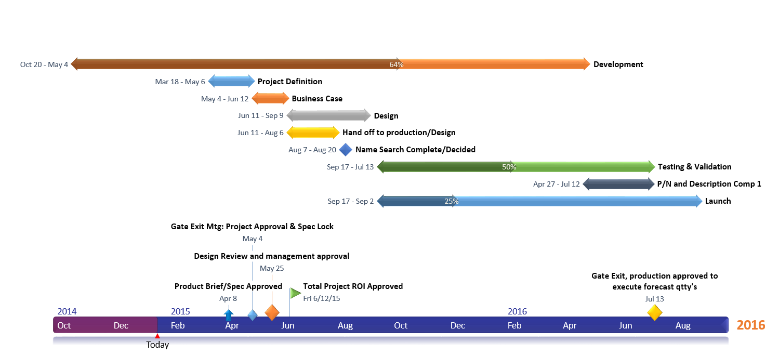
PowerPoint Timeline Template
3/1
Layout Logistics
3/7
Select Vendors
3/11
Hire Caterer
3/13
Buy
Decorations
3/10
Hire Venue
3/15
Hire Designer
Or, Make Your Own Timeline in Smartsheet
Copy and Paste this Link: http://bit.ly/smartsheet-timeline-ppt

